Slide 1
Handling User Input

Slide 2
Credits
Some of the contents of this slide presentation have been referenced and reproduced from the textbook for this course, PHP Programming with MySQL (Second Edition) , Don Gosseling, Diana Kokoska, and Robert Easterbrooks, ©2011, Cengage Learning, All Rights Reserved. ISBN 978-0-5387-4584-0.
Thank you for some references to Kevin Skoglund, from PHP with MySQL Essential Training (2013), ©2017 LinkedIn Corporation.

Slide 3
LEARNING OBJECTIVES
Learn about superglobal variables
Build HTML web forms for PHP
Process form data
Handle submitted form data
Create an all-in-one form
Display dynamic data based on a URL token

Slide 4
Introduction
Building Web Pages with PHP
Request/Response Cycle
Requests start at the browser
Web server processes the PHP
Returns an HTML page back to the browser
Three ways to get data from the user, each corresponds to an HTTP method or verb
URLs / Links : GET
Forms: POST
Cookies: COOKIE (not really a verb, an access method)

Slide 5
Using Superglobals
Superglobals
Contain the data needed to process the web interactions
Sometimes called autoglobals
Superglobals are predefined global arrays
Provide information about server, environment, and user input
Superglobals are associative arrays

Slide 6
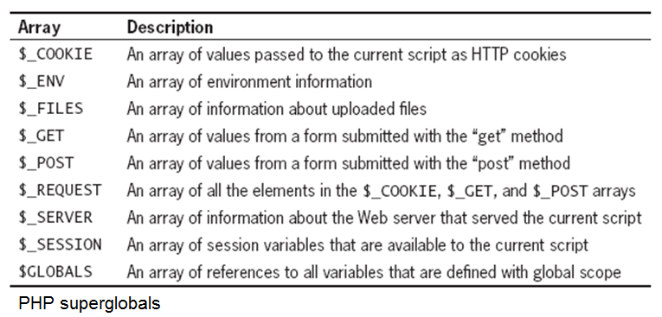
Using Superglobals
Superglobals

Slide 7
Using Superglobals
Associative Arrays
An object-indexed collection of objects
Similar to regular arrays, but not integer indexed
Instead, it is indexed by a label of some sort
It is not ordered, because the elements are not numbered
Instead of locating element number X, we locate element labeled ‘something’

Slide 8
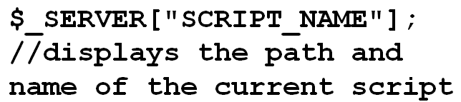
Using Superglobals
Associative Arrays
The element label is called the key
The key may be an alphanumeric value in single or double quotes
Associative arrays form elements which are key / value pairs
The value is stored in the element labeled by the key
Superglobal example

Slide 9
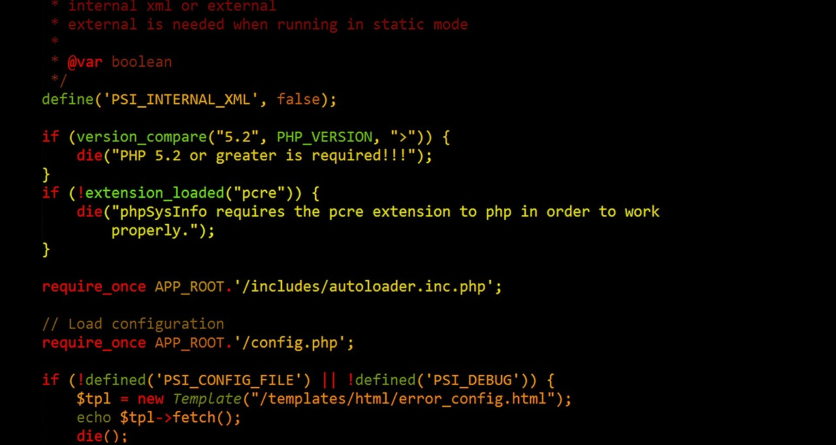
Using Superglobals
Programming Exercise 02_04_01 – Step 1
Using Superglobals

Slide 10
HTML Web Forms for PHP
HTML Web Forms
Contain interactive controls that allow users to enter and submit data
Designed expressly for submission to a processing script
PHP is designed to play extremely well with them
Use a standard HTML <form> element with two required attributes for the target script
action: identifies the target on the Web server that will process the form data when it is submitted
method: specifies the HTTP verb or method used to send to the target script

Slide 11

HTML Web Forms for PHP
Web Form Attributes - action
The opening form tag requires an action attribute
The value of the action attribute identifies the target program on the Web server that will process the form data when the form is submitted
Example

Slide 12
HTML Web Forms for PHP
Web Form Attributes - method
The value of the method attribute must be either ”post” or ”get”
The post method embeds the form data in the request message
PHP automatically creates and populates a $_POST superglobal array containing the data
The get method appends the form data to the URL specified in the form’s action attribute
PHP automatically creates and populates a superglobal $_GET array containing the data

Slide 13
HTML Web Forms for PHP
Web Form Data Transmission
Form fields are sent to the Web server as name/value pairs
The name portion of the name/value pair becomes the key of an element in either the $_POST or $_GET array
The value portion of the name/value pair is populated in the array element by the data that the user enters in the control on the Web form

Slide 14
HTML Web Forms for PHP
Web Form Data Transmission
With the get method, form data is appended to the URL specified by the action attribute
Name/value pairs appended to the URL are called URL tokens
The form data is separated from the URL by a question mark ( ? )
The individual name/value pairs are separated by an ampersand ( & )
The element name is separated from the value by an equal sign ( = ).
Spaces in the name and value fields are encoded as plus signs ( + )

Slide 15
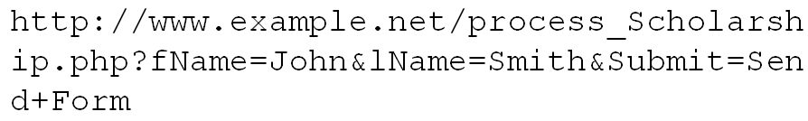
HTML Web Forms for PHP
Web Form Data Transmission
Other legal characters with the get method
Letters, numbers, hyphens ( - ), underscores ( _ ) and periods ( . )
All other characters, like quotes and ampersands, are encoded using a percent sign ( % ) followed by the two-digit hexadecimal representation of the character’s ASCII value
Example get URL

Slide 16
HTML Web Forms for PHP
Web Form Data Transmission
Limitations of the get method for submitting form data
The number of characters that can be appended to a single variable is limited to 100
The form values are appended to the URL in plain text, making a URL request insecure
Advantage of the get method for submitting form data
Passed values are visible in the Address Bar of the browser
Therefore URL and its data can be bookmarked

Slide 17
HTML Web Forms for PHP
Programming Exercise 02_04_01 – Step 2
Build an HTML Web Form for PHP

Slide 18
Processing Form Data
PHP Form Handler
A form handler is a program or script that processes the information submitted from a Web form
A form handler usually performs the following tasks
Verifies that the user entered the minimum amount of data to process the form
Validates form data
Process the submitted data
Returns appropriate output as a Web page

Slide 19
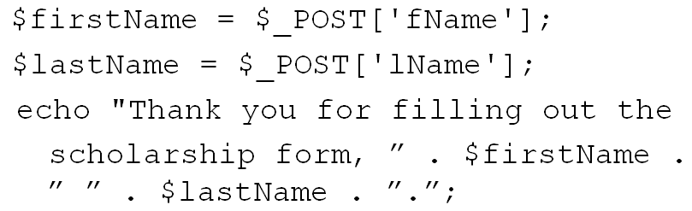
Processing Form Data
PHP Form Handler
Retrieving Submitted Data
The values stored in the superglobal $_POST associative array are easily retrieved by PHP
Therefore, the names of the name / value pairs must be known as part of the specification
Example

Slide 20
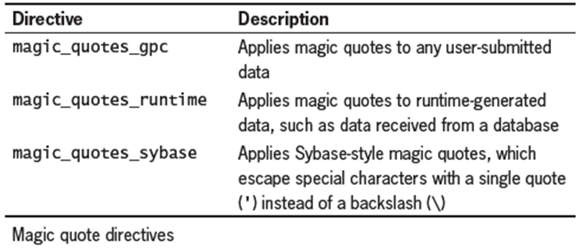
Processing Form Data
User Data and Undesirable Characters
User’s can enter dangerous input into form fields
PHP has some protection mechanisms for this
Older PHP uses Magic Quotes, now out of favor
Adds a backslash ( \ ) escape character to any single quote, double quote, or NULL character contained in form data that a user submits to a PHP script

Slide 21
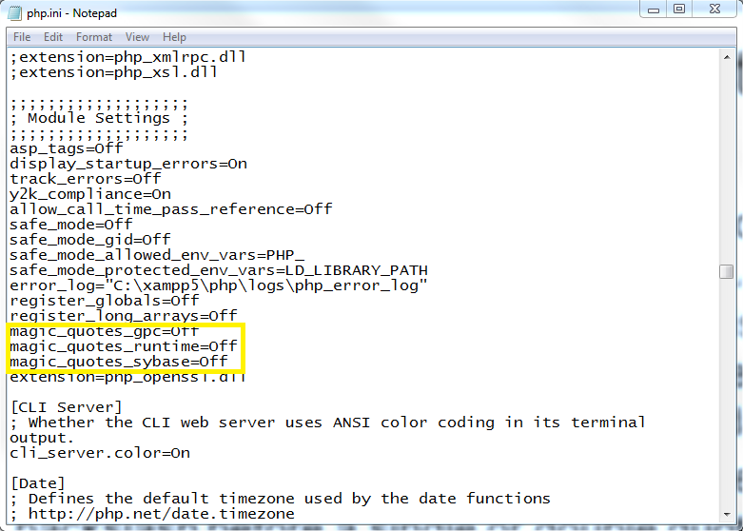
Processing Form Data
User Data and Undesirable Characters
Magic Quotes, should be turned off on server in php.ini, which is default, if any output bugs appear

Slide 22
Processing Form Data
User Data and Undesirable Characters
More modern safe data handling
addslashes()function: adds a backslash before a single or double quote or a NULL character in user input (if magic quotes is disabled, this is the alternative to escape a character before saving to a text file or database)
stripslashes()function removes a backslash before a single or double quote or NULL character in user input (if magic quotes is enabled, this is required before outputting a string with the echo statement)

Slide 23
Processing Form Data
Programming Exercise 02_04_01 – Step 3
Creating a PHP Form Handler

Slide 24
Handling Submitted Form Data
Checking Submitted Data
It is necessary to validate Web form data to ensure it is complete, valid, and safe
The optimal way to ensure valid form data is client-side
Only allow the user to enter an acceptable response
Examples of data validation include verifying that
Any required fields are not blank
E-mail addresses and other data in the correct format
No exceeding the word limits in controls
Many others

Slide 25
Handling Submitted Form Data
Validating Required Fields
With the post or get methods, most controls get sent to the server even if they do not contain data
Exceptions are unchecked radio buttons and checkboxes
The empty()function is used to determine if a variable contains a value
Returns false if the variable being checked has a nonempty and nonzero value
Returns a value of true if the variable has an empty or zero value

Slide 26
Handling Submitted Form Data
Validating Field Data
Refers to verifying that the value entered in a field is appropriate for the data type that should have been entered
The best way to ensure valid form data is client-side
Build the Web form with proper HTML controls (such as check boxes, radio buttons, and selection lists) that only allow the user to select valid responses
Use a variety of custom validation techniques

Slide 27
Handling Submitted Form Data
Validating Numeric Data
All data in a Web form is string data
PHP automatically converts string data to numeric data if the string is a number
The is_numeric()function can be used to determine if a variable contains a number
The round()function can be used give a numeric variable an appropriate number of decimal places

Slide 28
Handling Submitted Form Data
Validating String Data
Regular expression functions are some of the best tools for verifying that string data meets the strict formatting required for e-mail addresses, Web page URLs, or date values
The stripslashes()function removes the leading slashes for escape sequences
The trim()function removes any leading or trailing white space from a string

Slide 29
Handling Submitted Form Data
Programming Exercise 02_04_01 – Step 4
Handling Submitted Form Data

Slide 30
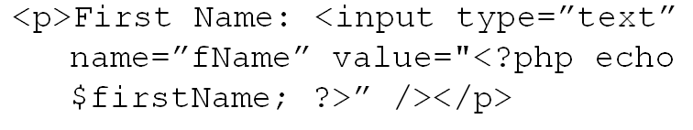
Handling Submitted Form Data
Redisplaying the Web Form
A sticky form is used to redisplay the form with the controls set to the values the user entered the last time the form was submitted
Keeps the user from having to enter any but the non-valid fields
Syntax

Slide 31
Handling Submitted Form Data
Programming Exercise 02_04_01 – Step 5
Redisplaying the Web Form

Slide 32
Creating an All-in-One Form
All-in-One Forms
A two-part form has one page that displays the form and one page that processes the form data
For simple forms that require only minimal processing, it’s often easier to use an All-in-One form—a single script used display a Web form and process its data
An All-in-One form uses two conditionals
The first determines if the form has been submitted and needs to be validated
The second determines if redisplay is necessary

Slide 33
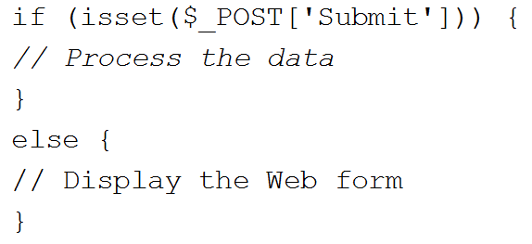
Creating an All-in-One Form
Determining if the Form has been Submitted
A conditional determines if the form has been submitted or if it is being viewed for the first time
The isset()function is used to determine if the $Submit variable has been set
If the data did not pass all validation checks or no data entered, will display the Web form, for the user to enter data for the first time or re-enter data that did not pass

Slide 34
Creating an All-in-One Form
Programming Exercise 02_04_01 – Step 6
Creating an All-in-One Form

Slide 35
Dynamic Content with URL Tokens
Display Dynamic Content Using a URL Token
The POST method is best for form data, it is secure and unlimited in size
The GET method is ideal for embedding options in a hyperlink
By passing URL tokens to a PHP script, many different types of information can be displayed from the same script
A Web page template with static sections and a dynamic content section, a single PHP script can produce the same content as multiple static XHTML pages

Slide 36
Dynamic Content with URL Tokens
Using a Web Page Template
A Web template is a single Web page that is divided into separate sections such as
Header
Navigation
Dynamic Content
Footer
The contents of the individual sections are populated using include files
<?php include(inc_header.php)?>

Slide 37
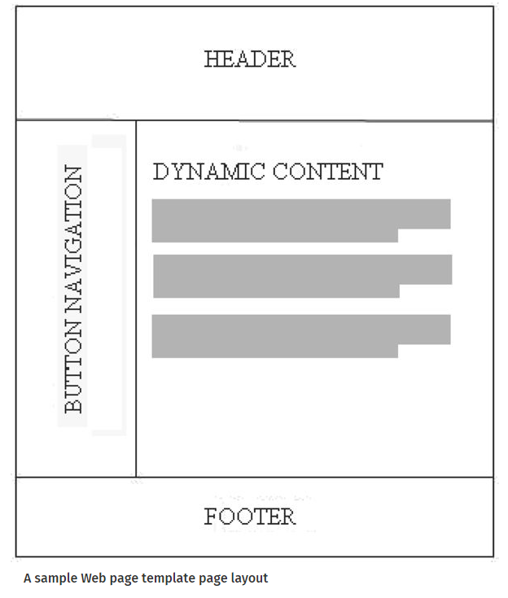
Dynamic Content with URL Tokens
Using a Web Page Template

Slide 38
Dynamic Content with URL Tokens
Using Text Hyperlinks for Navigation
Clicking on a text hyperlink replaces the contents of the browser URL bar with the contents referenced by the hyperlink href attribute
A name/value pair is appended to the URL, which can be referenced in the dynamic data section of the target PHP file
The name is user defined
The value is user defined

Slide 39
Dynamic Content with URL Tokens
Programming Exercise 02_04_01 – Step 7
Creating a Web Page Template

